Slide 1


SMART INDIA HACKATHON 2019 (SOFTWARE EDITION)
HACK-RED
High Impact Low Cost Well- Being Solution

Slide 2
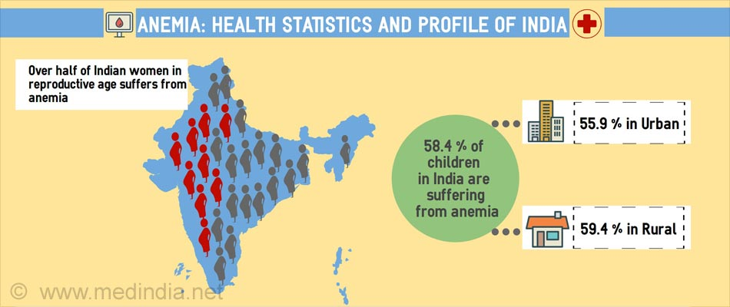
https://www.google.com/search?rlz=1C1CHBF_enIN730IN730&biw=1366&bih=576&tbm=isch&sa=1&ei=AP50XJroFcuoyAOlzqr4Dw&q=statistics+of+anemia+in+india&oq=statistics+of+anemia+&gs_l=img.3.1.0i30j0i24l2.32040.32040..34427...0.0..0.79.79.1......1....1..gws-wiz-img.G0B-zRWTo-A#imgrc=96AdCK1E_TK73M:

Slide 3
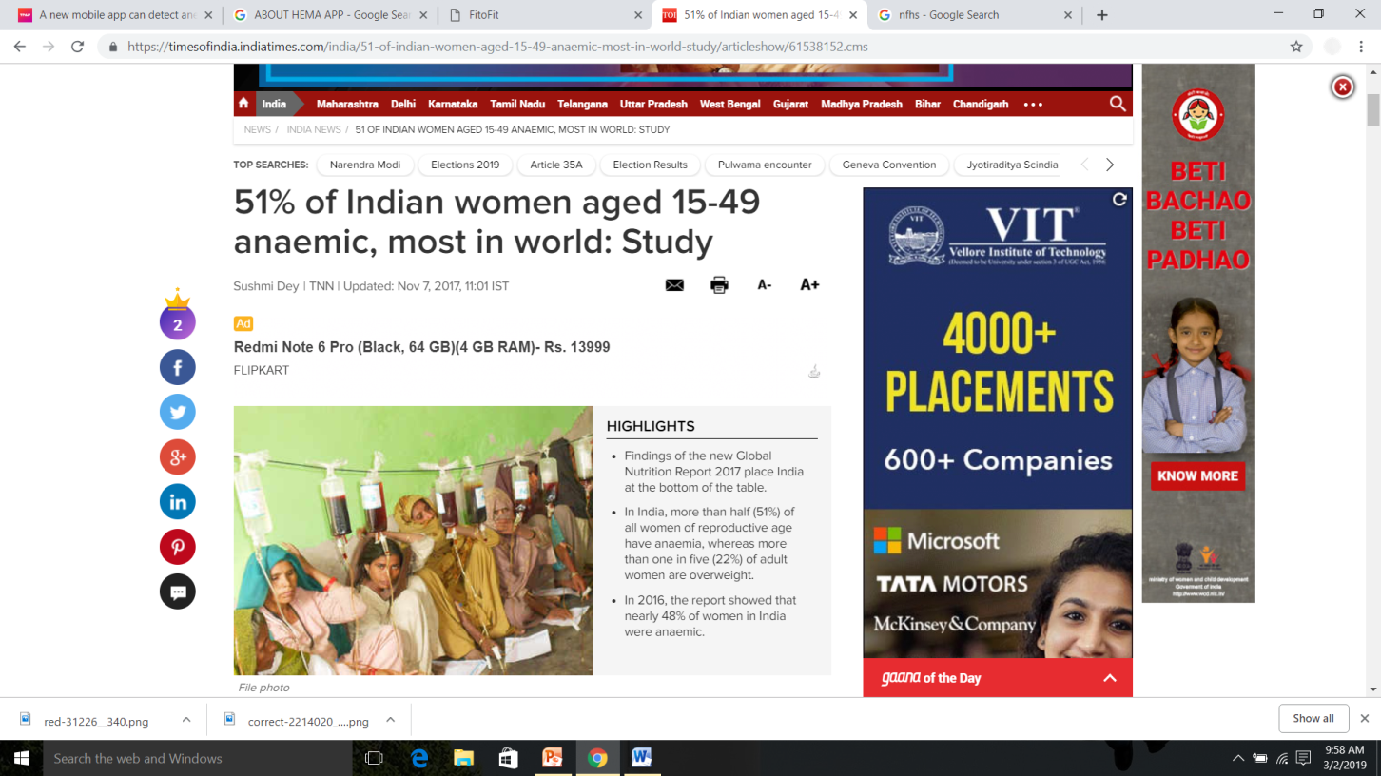
2017 TIMES OF INDIA GLOBAL NUTRITION REPORT

Slide 4
EFFECTS OF ANEMIA
Impaired fetal development ,
Impaired development of cognitive abilities,
Limited learning capacity in children,
Reduced working & productive capacity
Weakness, Fatigue,
Dizziness,
Drowsiness,
Defective linear growth in children.
It is a serious socio-economic political illness – Need to be addressed.

Slide 5
OBJECTIVE
Low cost – Screening using smartphones.
High impact – Mass people can be screened non-invasively.
Reduce Communication - Addressing time, language and cultural barriers – Text chatbots in regional language in doctor patient interactions .
Well Being - Improve overall medical care and ensure wellness.

Slide 6

NON INVASIVE SCREENING OF ANEMIA
EyeNemia

Slide 7
Normal Haemoglobin Count Widely Accepted by Physicians
Age/ Gender | Normal Hb (Anemic if less than : )[g/dl]
Children (0.5 – 5 yrs) | 11.0
Children (5 – 12 yrs) | 11.5
Teens ( 12 – 15 yrs) | 12.0
Women , Non-pregnant (>15yrs) | 12.0
Women , pregnant | 11.0
Men (>15 yrs) | 13.0

Slide 8

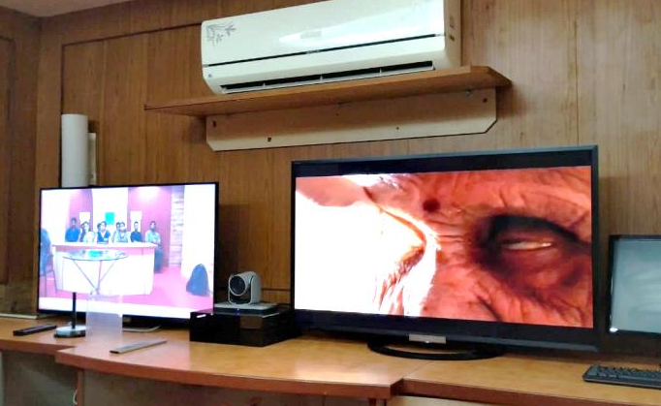
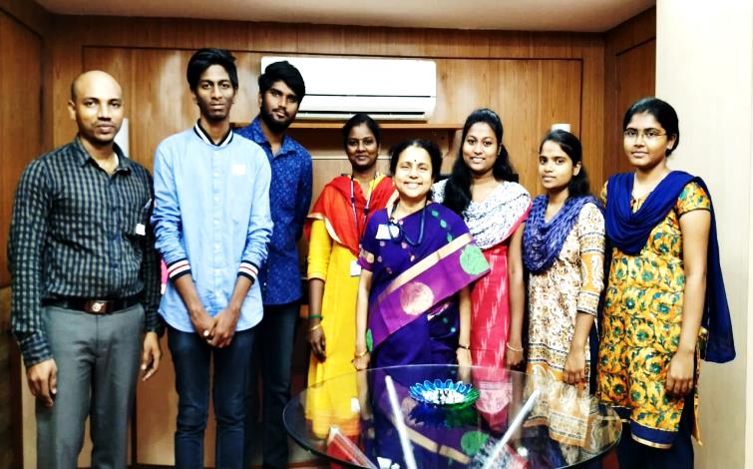
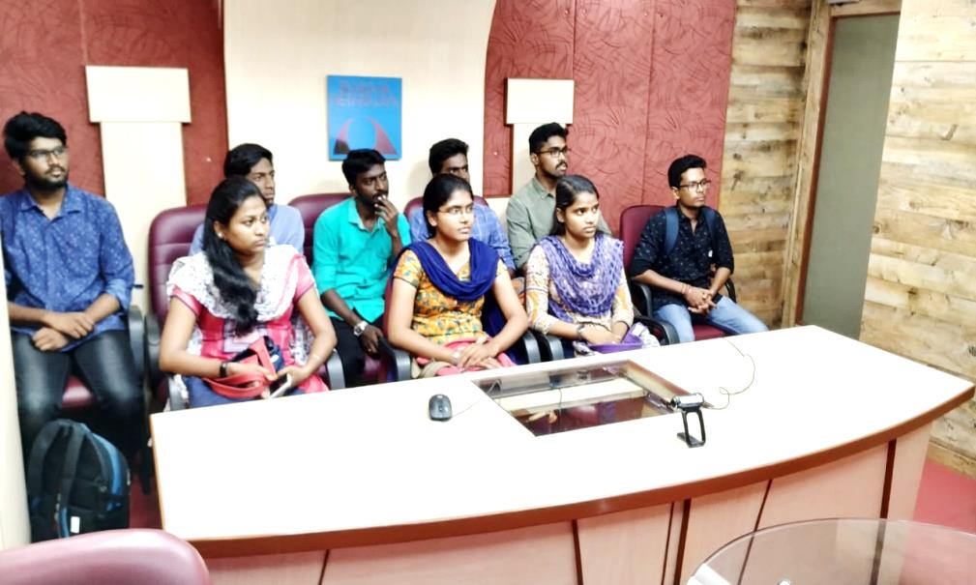
VISIT TO SANKARA NETHRALAYA
Got samples from Teleopthalmology Department about the requirements for mass screening and conjunctiva images along with haemoglobin values.

Slide 9
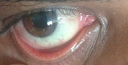
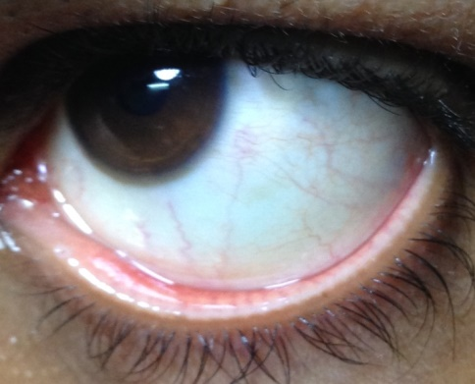
DATA ACQUISITION
Approval for this experiment was obtained from ethical clearance board
Sample eye images were collected from Sankara Nethralaya with different lighting conditions.

Slide 10
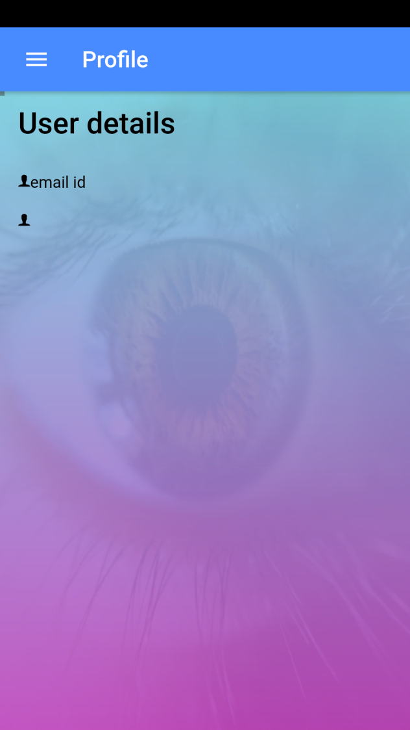
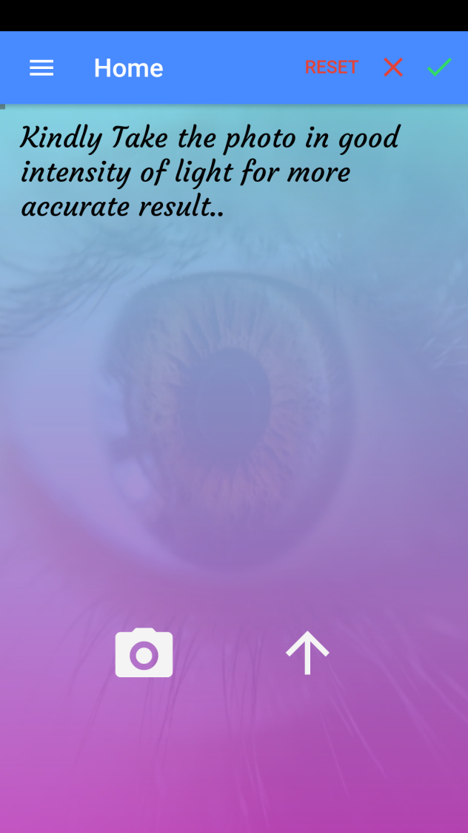
App developed – low cost solution

Slide 11
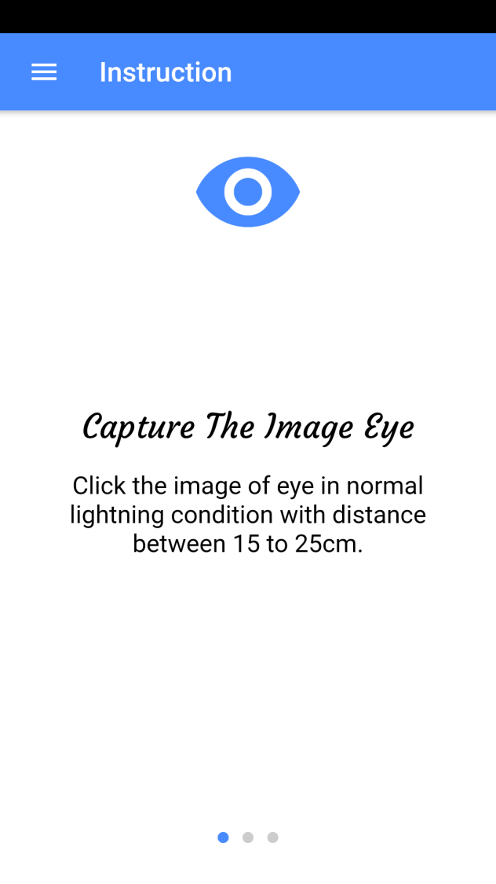
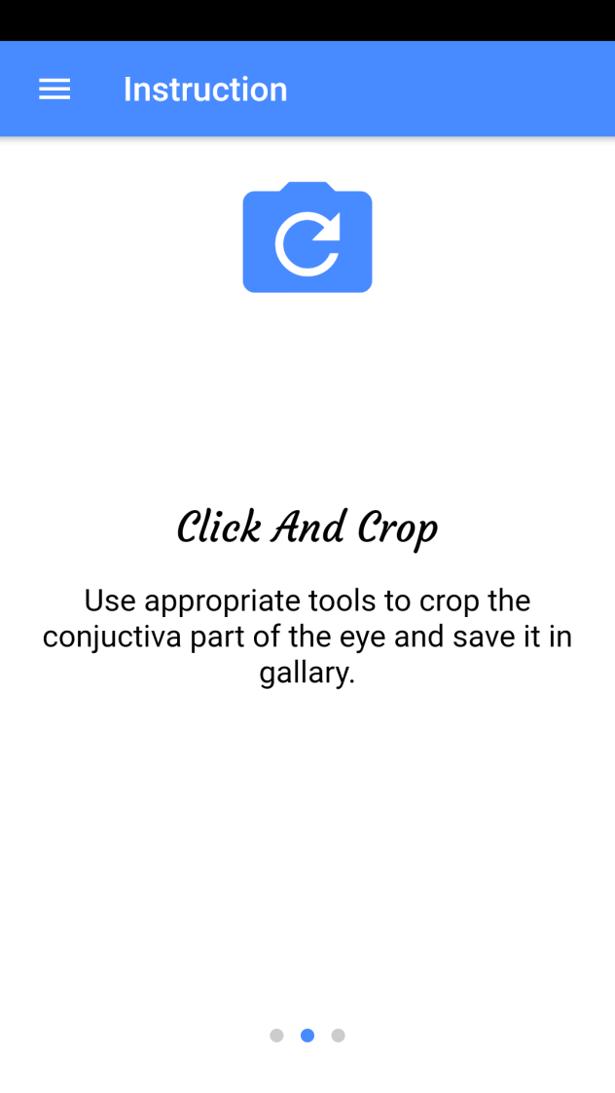
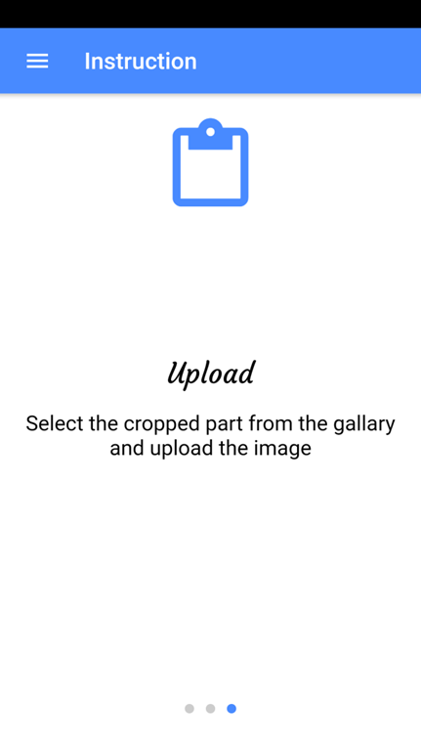
App developed – low cost solution

Slide 12
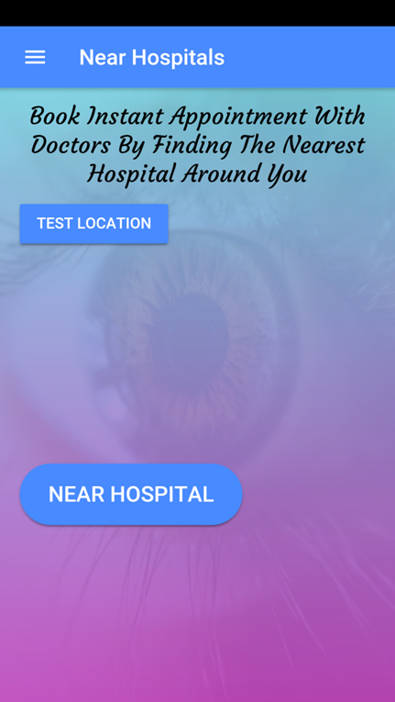
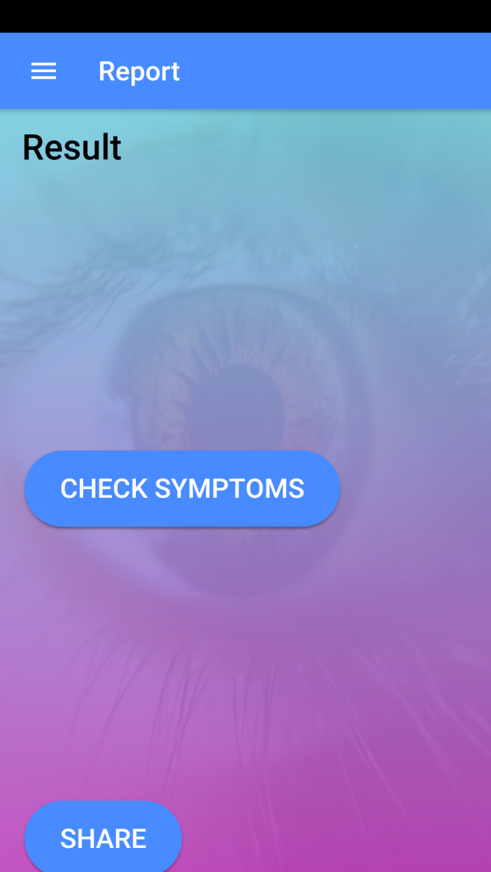
Interface-Communication

Slide 13
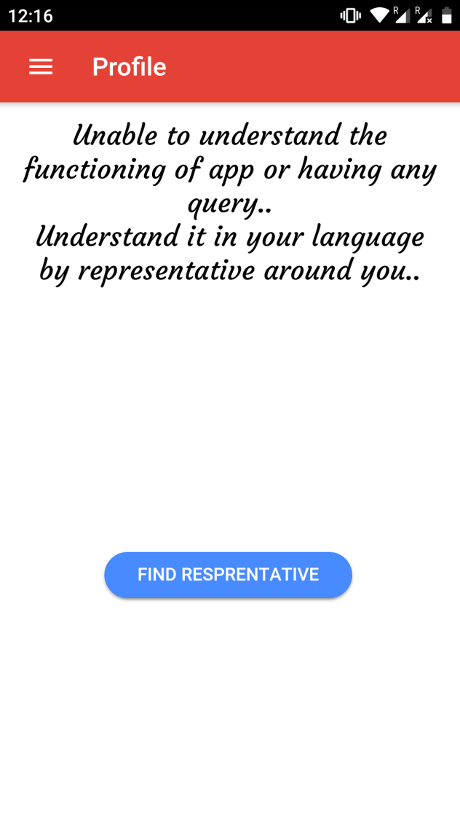
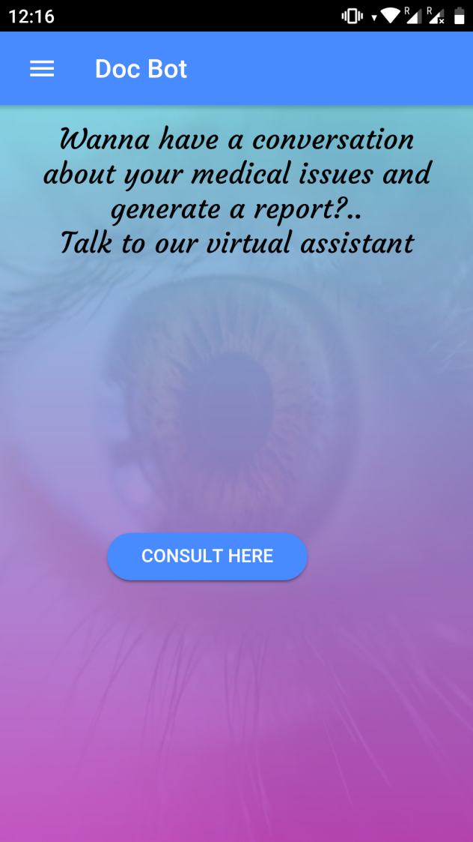
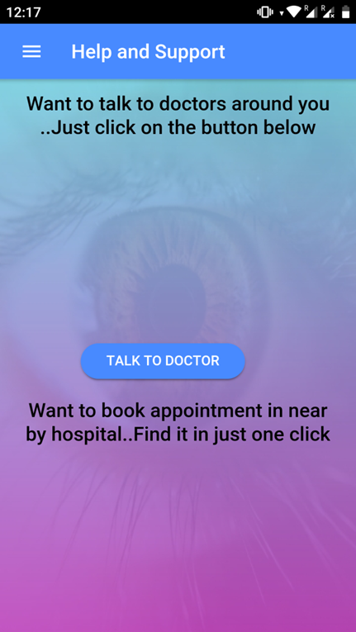
Interface - Communication(English)

Slide 14
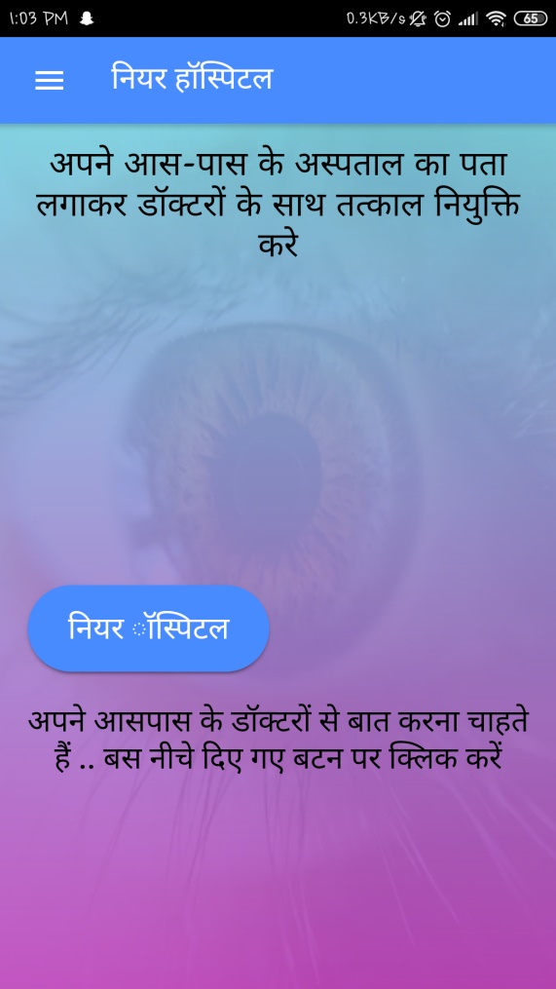
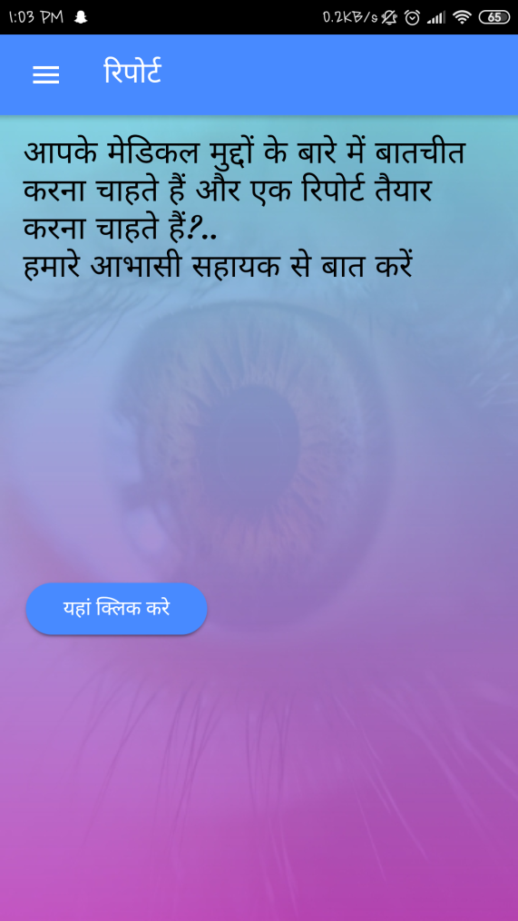
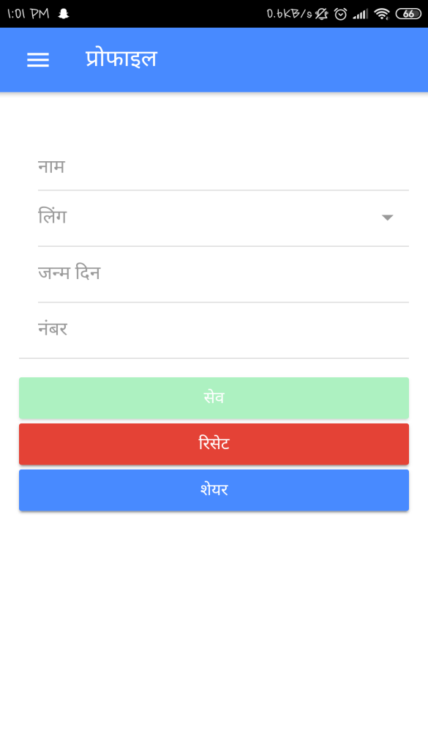
Interface - Communication(Hindi)

Slide 15

Chatbot which generates reports based on symptoms

Slide 16
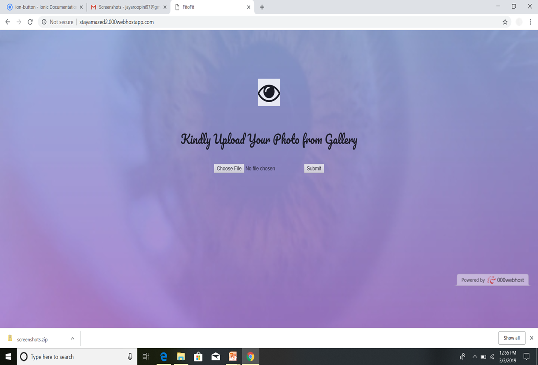
Web Application

Slide 17
Thank you

